Slide 1
Traversing the Ethereum Blockchain
Using Graph Database Infrastructure to Analyze the World’s Largest Cryptocurrency Exchange
Matt Ahlborg
December, 2018

Slide 2
What is a blockchain?
What is Ethereum?
A blockchain is a database holding a history of transactions,
The transactions are denominated in a particular digital currency token.
Ethereum is one instance of a blockchain,
350M transactions in its history,
Transactions are denominated in the ETH token,
50M wallets hold ETH,
600GB in size.
Notes:
The ethereum blockchain, like Bitcoin and other blockchains, is simply a database holding...

Slide 3

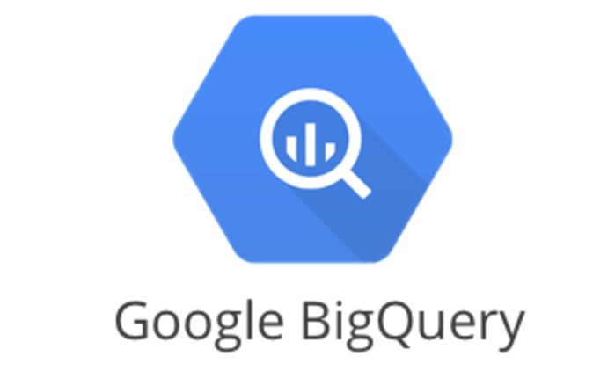

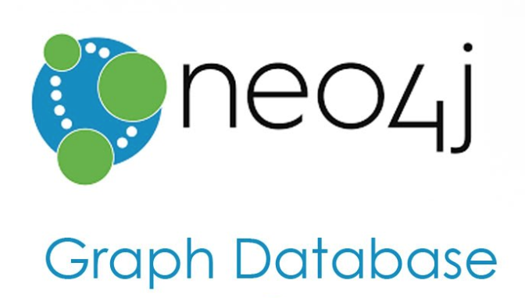
The Process:

Slide 4
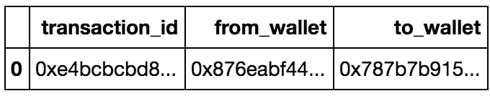
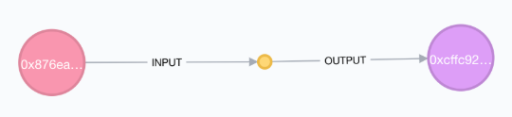
Database Comparison:
SQL Database
Neo4j Graph Database

Slide 5
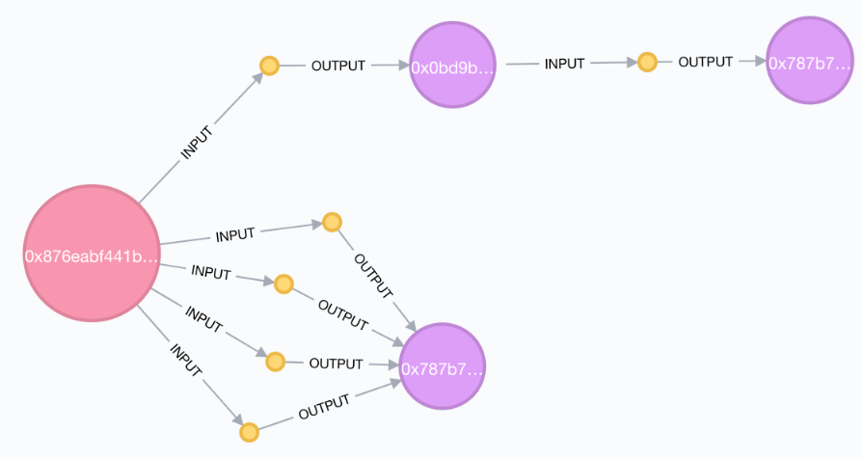
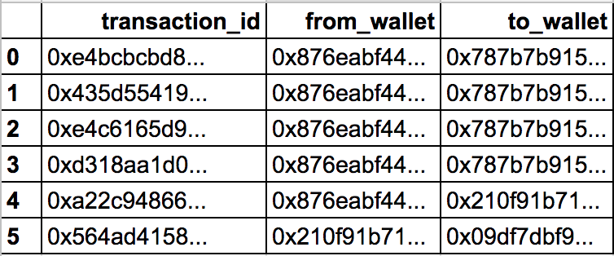
Database Comparison:
SQL Database
Neo4j Graph Database

Slide 6
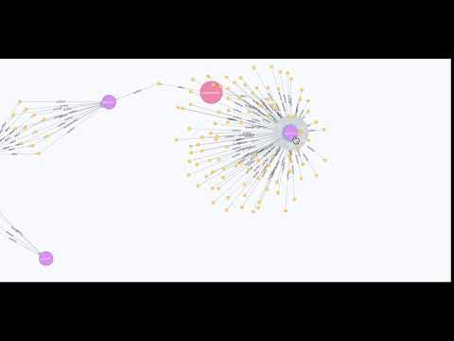

Slide 7
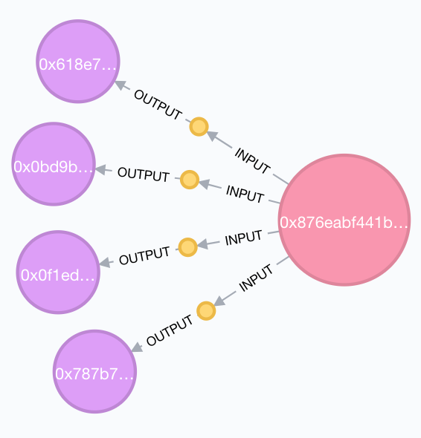

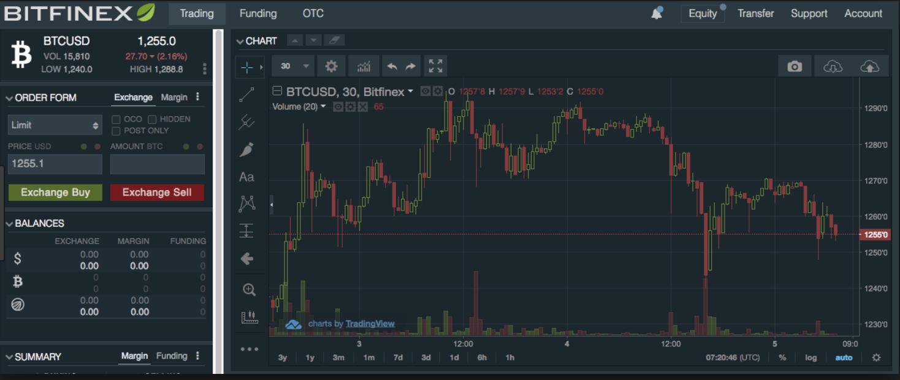
Ethereum Blockchain
User Account
Bitfinex Trading Platform
Buy/Sell Execution
Notes:
In the scenario I was looking at, users are transferring eth to and from their wallets to the bitfinex wallet where bitfinex then...
And using the power of a graph database, I was able engineer features which relied heavily upon transaction paths

Slide 8
Unsupervised Model Features:
Generic:
Transaction events per address,
ETH Volume per address,
Fee paid per transaction.
Pathing:
N-nodes of separation between known wallets,
Number of temporary wallets traversed until coming to a rest,
Dispersion to many wallets and reconsolidation back to few wallets.
Notes:
Generic features one would expect in any sort of financial modeling, the pathing
Model Features:
The usual features:
Number of transactions
Value of transactions
Fee amount
Pathing Features
Number of hops until coming to a rest
Dispersion and Reconsolidation factors
Nth degree association with other wallets

Slide 9
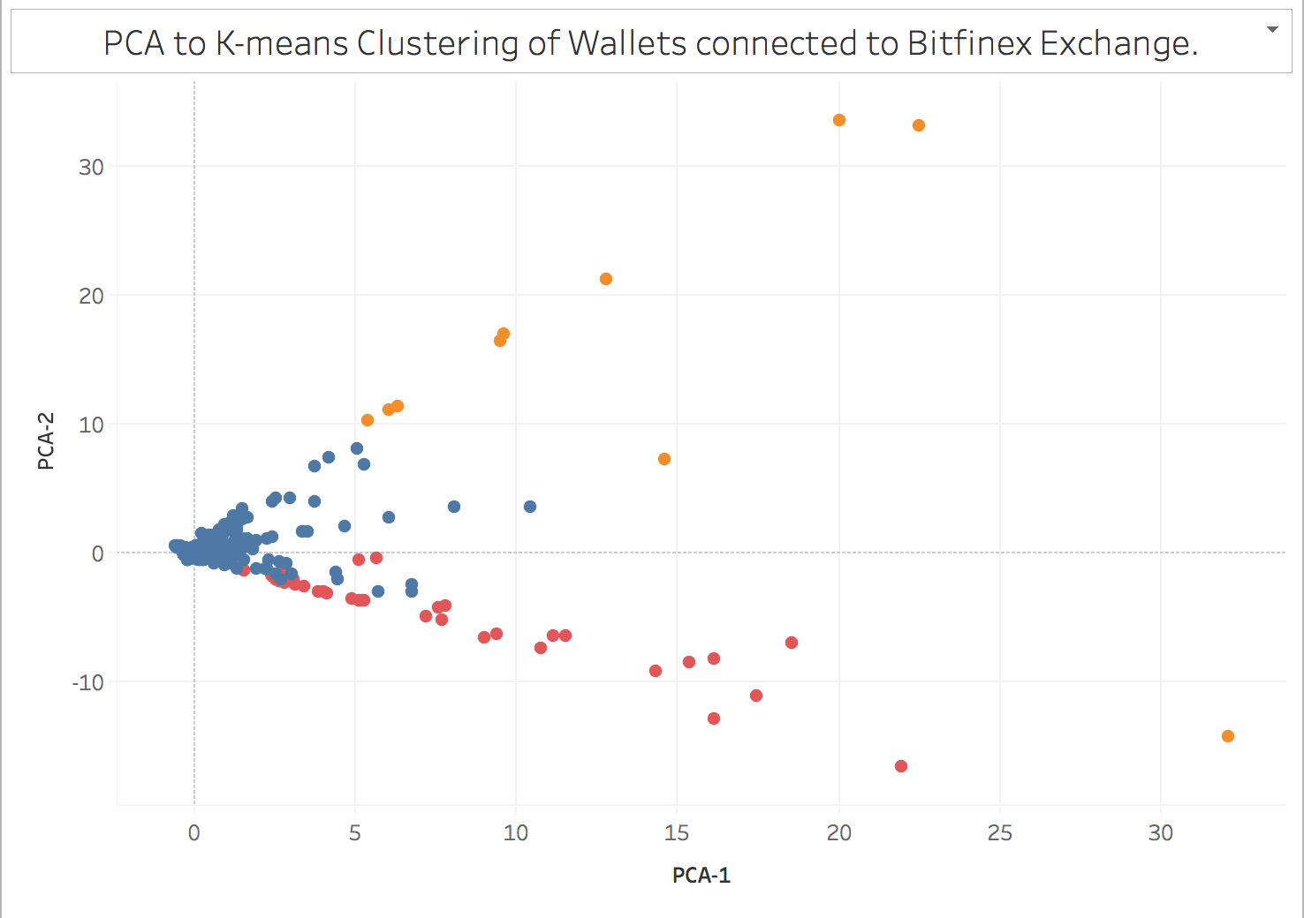
Augur Altcoin
Topics
Orange: Altcoins and Sub-Tokens.
Blue: Multi-Exchange arbitrage, higher frequency traders
Red: Ethereum whales, medium-low frequency traders.
0x Altcoin
Touches four other major exchanges
Average balance of 17,000 ETH ($4.25M USD)

Slide 10

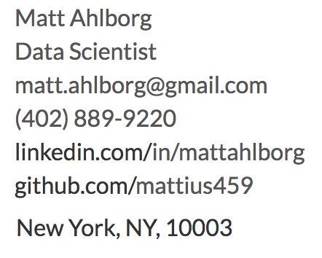
Notes:
To-do:
Better video clip

